Slide 1
Iterative Improvement
Algorithm design technique for solving optimization problems
Start with a feasible solution
Repeat the following step until no improvement can be found:
  change the current feasible solution to a feasible solution with a better value of the objective function
Return the last feasible solution as optimal
Note: Typically, a change in a current solution is “small” (local search)
Major difficulty: Local optimum vs. global optimum
Notes:
These were discussed in the first lecture. At this point, the claims made then about
“efficient” algorithms can be discussed in more concrete terms.
Before launching into this lecture, I usually read to my students the introductory whimsical
example from Garey and Johnson “Computers and Intractability”, while showing
overhead transparencies of their cartoons. These are not reproduced here because it would
require copyright clearance.

Slide 2
Important Examples
simplex method
Ford-Fulkerson algorithm for maximum flow problem
maximum matching of graph vertices
Gale-Shapley algorithm for the stable marriage problem
local search heuristics

Slide 3
Linear Programming
Linear programming (LP) problem is to optimize a linear function of several variables subject to linear constraints:
maximize (or minimize) c₁ x₁ + ...+ c_{n} x_{n}
subject to a_{i 1}x₁+ ...+ a_{in} x_{n} ≤ (or ≥ or =) b_{i} , i = 1,...,m x₁ ≥ 0, ... , x_{n} ≥ 0
The function z = c₁ x₁ + ...+ c_{n} x_{n} is called the objective function;
constraints x₁ ≥ 0, ... , x_{n} ≥ 0 are called nonnegativity constraints

Slide 4
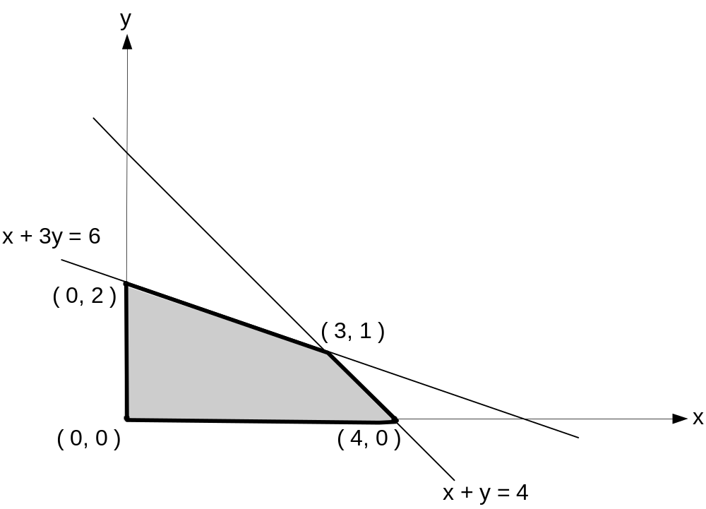
Example
maximize 3x + 5y
subject to x + y ≤ 4
x + 3y ≤ 6
x ≥ 0, y ≥ 0
Feasible region is the set of points defined by the constraints

Slide 5
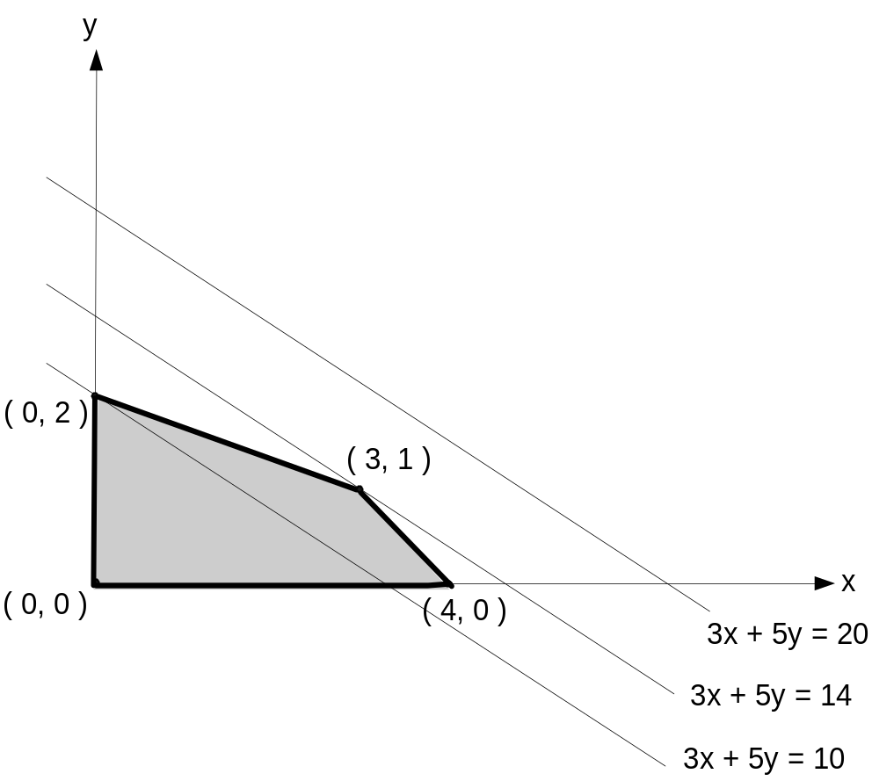
Geometric solution
maximize 3x + 5y
subject to x + y ≤ 4
x + 3y ≤ 6
x ≥ 0, y ≥ 0
Optimal solution: x = 3, y = 1
Extreme Point Theorem Any LP problem with a nonempty bounded feasible region has an optimal solution; moreover, an optimal solution can always be found at an extreme point of the problem's feasible region.

Slide 6
3 possible outcomes in solving an LP problem
has a finite optimal solution, which may no be unique
unbounded: the objective function of maximization (minimization) LP problem is unbounded from above (below) on its feasible region
infeasible: there are no points satisfying all the constraints, i.e. the constraints are contradictory

Slide 7
The Simplex Method
The classic method for solving LP problems;
one of the most important algorithms ever invented
Invented by George Dantzig in 1947
Based on the iterative improvement idea:
  Generates a sequence of adjacent points of the problem’s feasible region with improving values of the objective function until no further improvement is possible

Slide 8
Standard form of LP problem
must be a maximization problem
all constraints (except the nonnegativity constraints) must be in the form of linear equations
all the variables must be required to be nonnegative
Thus, the general linear programming problem in standard
form with m constraints and n unknowns (n ≥ m) is
maximize c₁ x₁ + ...+ c_{n} x_{n}
subject to a_{i 1}x₁+ ...+ a_{in} x_{n} = b_{i} , i = 1,...,m, x₁ ≥ 0, ... , x_{n} ≥ 0
Every LP problem can be represented in such form

Slide 9
Example
maximize 3x + 5y maximize 3x + 5y + 0u + 0v
subject to x + y ≤ 4 subject to x + y + u = 4
x + 3y ≤ 6 x + 3y + v = 6
x≥0, y≥0 x≥0, y≥0, u≥0, v≥0
Variables u and v, transforming inequality constraints into
equality constrains, are called slack variables

Slide 10
Basic feasible solutions
A basic solution to a system of m linear equations in n unknowns (n ≥ m) is obtained by setting n – m variables to 0 and solving the resulting system to get the values of the other m variables. The variables set to 0 are called nonbasic; the variables obtained by solving the system are called basic.
A basic solution is called feasible if all its (basic) variables are nonnegative.
Example x + y + u = 4
x + 3y + v = 6
(0, 0, 4, 6) is basic feasible solution
(x, y are nonbasic; u, v are basic)
There is a 1-1 correspondence between extreme points of LP’s feasible region and its basic feasible solutions.

Slide 11
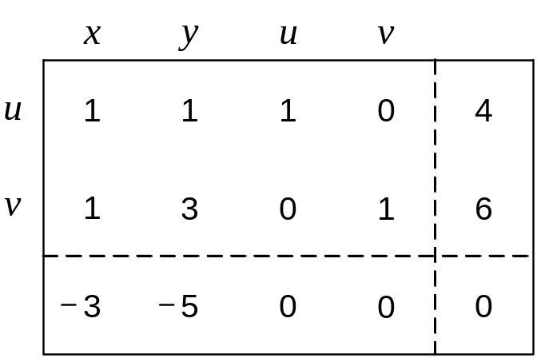
Simplex Tableau
maximize z = 3x + 5y + 0u + 0v
subject to x + y + u = 4
x + 3y + v = 6
x≥0, y≥0, u≥0, v≥0
basic feasible solution
(0, 0, 4, 6)
basic variables
objective row
value of z at (0, 0, 4, 6)

Slide 12
Outline of the Simplex Method
Step 0 [Initialization] Present a given LP problem in standard form and set up initial tableau.
Step 1 [Optimality test] If all entries in the objective row are nonnegative — stop: the tableau represents an optimal solution.
Step 2 [Find entering variable] Select (the most) negative entry in the objective row. Mark its column to indicate the entering variable and the pivot column.
Step 3 [Find departing variable] For each positive entry in the pivot column, calculate the θ-ratio by dividing that row's entry in the rightmost column by its entry in the pivot column. (If there are no positive entries in the pivot column — stop: the problem is unbounded.) Find the row with the smallest θ-ratio, mark this row to indicate the departing variable and the pivot row.
Step 4 [Form the next tableau] Divide all the entries in the pivot row by its entry in the pivot column. Subtract from each of the other rows, including the objective row, the new pivot row multiplied by the entry in the pivot column of the row in question. Replace the label of the pivot row by the variable's name of the pivot column and go back to Step 1.

Slide 13
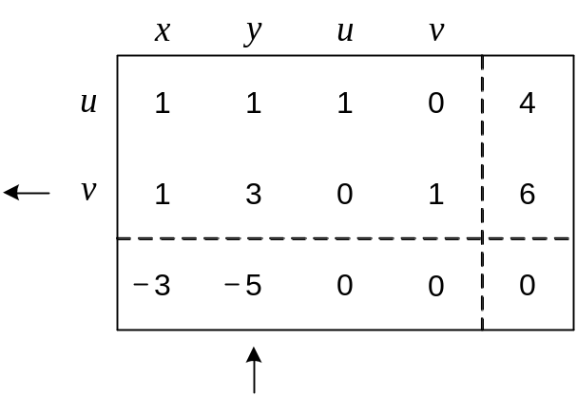
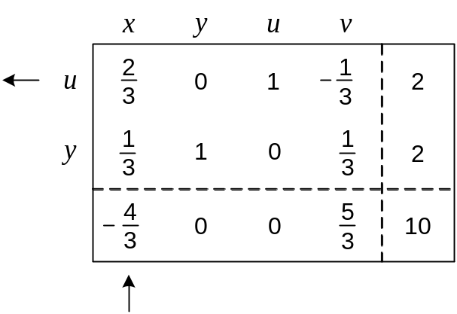
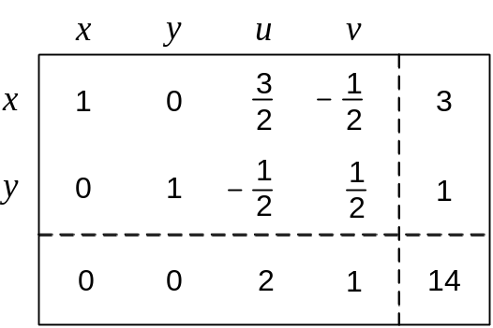
Example of Simplex Method Application
maximize z = 3x + 5y + 0u + 0v
subject to x + y + u = 4
x + 3y + v = 6
x≥0, y≥0, u≥0, v≥0
maximize z = 3x + 5y + 0u + 0v
subject to x + y + u = 4
x + 3y + v = 6
x≥0, y≥0, u≥0, v≥0
basic feasible sol. (0, 0, 4, 6)
z = 0
basic feasible sol. (0, 2, 2, 0)
z = 10
basic feasible sol. (3, 1, 0, 0)
z = 14

Slide 14
Notes on the Simplex Method
Finding an initial basic feasible solution may pose a problem
Theoretical possibility of cycling
Typical number of iterations is between m and 3m, where m is
the number of equality constraints in the standard form
Worse-case efficiency is exponential
More recent interior-point algorithms such as Karmarkar’s
algorithm (1984) have polynomial worst-case efficiency and
have performed competitively with the simplex method in
empirical tests

Slide 15
Maximum Flow Problem
Problem of maximizing the flow of a material through a transportation network (e.g., pipeline system, communications or transportation networks)
Formally represented by a connected weighted digraph with n vertices numbered from 1 to n with the following properties:
  contains exactly one vertex with no entering edges, called the source (numbered 1)
  contains exactly one vertex with no leaving edges, called the sink (numbered n)
  has positive integer weight u_{ij} on each directed edge (i.j), called the edge capacity, indicating the upper bound on the amount of the material that can be sent from i to j through this edge

Slide 16
Example of Flow Network
5
4
3
Source
2
5
2
1
2
3
6
3
Sink
1
4

Slide 17
Definition of a Flow
A flow is an assignment of real numbers x_{ij} to edges (i,j) of a given network that satisfy the following:
flow-conservation requirements
The total amount of material entering an intermediate
vertex must be equal to the total amount of the material
leaving the vertex
capacity constraints
0 ≤ x_{ij} ≤ u_{ij} for every edge (i,j) ∈ E
∑ x_{ji} = ∑ x_{ij} for i = 2,3,…, n-1
j: (j,i) є E j: (i,j) є E

Slide 18
Flow value and Maximum Flow Problem
Since no material can be lost or added to by going through intermediate vertices of the network, the total amount of the material leaving the source must end up at the sink:
    ∑ x_{1j} = ∑ x_{jn}
The value of the flow is defined as the total outflow from the source (= the total inflow into the sink).
The maximum flow problem is to find a flow of the largest value (maximum flow) for a given network.
j: (1,j) є E j: (j,n) є E

Slide 19
Maximum-Flow Problem as LP problem
Maximize v = ∑ x_{1j}
j: (1,j) ∈ E
subject to
∑ x_{ji} - ∑ x_{ij} = 0 for i = 2, 3,…,n-1
j: (j,i) ∈ E j: (i,j) ∈ E
0 ≤ x_{ij} ≤ u_{ij} for every edge (i,j) ∈ E

Slide 20
Augmenting Path (Ford-Fulkerson) Method
Start with the zero flow (x_{ij} = 0 for every edge)
On each iteration, try to find a flow-augmenting path from source to sink, which a path along which some additional flow can be sent
If a flow-augmenting path is found, adjust the flow along the edges of this path to get a flow of increased value and try again
If no flow-augmenting path is found, the current flow is maximum

Slide 21
Example 1
5
0/3
0/4
0/2
0/5
0/2
1
2
3
6
0/3
0/1
x_{ij}/u_{ij}
4
Augmenting path:
1→2 →3 →6

Slide 22
Example 1 (cont.)
5
0/3
0/4
2/2
2/5
2/2
1
2
3
6
0/3
0/1
4
Augmenting path:
1 →4 →3←2 →5 →6

Slide 23
Example 1 (maximum flow)
5
1/3
1/4
2/2
1/5
2/2
1
2
3
6
1/3
1/1
max flow value = 3
4

Slide 24
Finding a flow-augmenting path
To find a flow-augmenting path for a flow x, consider paths from source to sink in the underlying undirected graph in which any two consecutive vertices i,j are either:
  connected by a directed edge (i to j) with some positive unused capacity r_{ij} = u_{ij} – x_{ij}
    known as forward edge ( → )
    OR
  connected by a directed edge (j to i) with positive flow x_{ji}
    known as backward edge ( ← )
If a flow-augmenting path is found, the current flow can be increased by r units by increasing x_{ij} by r on each forward edge and decreasing x_{ji} by r on each backward edge, where
r = min {r_{ij} on all forward edges, x_{ji} on all backward edges}

Slide 25
Finding a flow-augmenting path (cont.)
Assuming the edge capacities are integers, r is a positive integer
On each iteration, the flow value increases by at least 1
Maximum value is bounded by the sum of the capacities of the edges leaving the source; hence the augmenting-path method has to stop after a finite number of iterations
The final flow is always maximum, its value doesn’t depend on a sequence of augmenting paths used

Slide 26
Performance degeneration of the method
The augmenting-path method doesn’t prescribe a specific way for generating flow-augmenting paths
Selecting a bad sequence of augmenting paths could impact the method’s efficiency
Example 2
2
0/U
0/U
1
0/1
3
U = large positive integer
0/U
0/U
4

Slide 27
Example 2 (cont.)
2
2
0/U
0/U
1/U
0/U
1
0/1
3
1
1/1
3
V=1
0/U
0/U
0/U
1/U
1→2→4→3
4
4
1→4←2→3
2
2
U/U
U/U
1/U
1/U
V=2U
1
0/1
3
● ● ●
1
0/1
3
V=2
U/U
U/U
1/U
1/U
4
4
Requires 2U iterations to reach maximum flow of value 2U

Slide 28
Shortest-Augmenting-Path Algorithm
Generate augmenting path with the least number of edges by BFS as follows.
Starting at the source, perform BFS traversal by marking new (unlabeled) vertices with two labels:
  first label – indicates the amount of additional flow that can be brought from the source to the vertex being labeled
  second label – indicates the vertex from which the vertex being labeled was reached, with “+” or “–” added to the second label to indicate whether the vertex was reached via a forward or backward edge

Slide 29
Vertex labeling
The source is always labeled with ∞,-
All other vertices are labeled as follows:
  If unlabeled vertex j is connected to the front vertex i of the traversal queue by a directed edge from i to j with positive unused capacity r_{ij} = u_{ij} –x_{ij} (forward edge), vertex j is labeled with l_{j},i⁺, where l_{j} = min{l_{i}, r_{ij}}
  If unlabeled vertex j is connected to the front vertex i of the traversal queue by a directed edge from j to i with positive flow x_{ji} (backward edge), vertex j is labeled l_{j},i⁻, where l_{j} = min{l_{i}, x_{ji}}

Slide 30
Vertex labeling (cont.)
If the sink ends up being labeled, the current flow can be augmented by the amount indicated by the sink’s first label
The augmentation of the current flow is performed along the augmenting path traced by following the vertex second labels from sink to source; the current flow quantities are increased on the forward edges and decreased on the backward edges of this path
If the sink remains unlabeled after the traversal queue becomes empty, the algorithm returns the current flow as maximum and stops

Slide 31
Example: Shortest-Augmenting-Path Algorithm
5
0/3
0/4
0/2
0/5
0/2
1
2
3
6
2,2⁺
0/3
0/1
5
4
0/3
0/4
∞,-
2,1⁺
2,3⁺
Queue: 1 2 4 3 5 6
↑ ↑ ↑ ↑
0/2
0/5
0/2
1
2
3
6
2,2⁺
0/3
0/1
4
3,1⁺
Augment the flow by 2 (the sink’s first label) along the path 1→2→3→6

Slide 32
Example (cont.)
5
0/3
0/4
2/2
2/5
2/2
1
2
3
6
1,2⁺
0/3
0/1
5
4
0/3
0/4
Queue: 1 4 3 2 5 6
↑ ↑ ↑ ↑ ↑
∞,-
1,3⁻
1,5⁺
2/2
2/5
2/2
1
2
3
6
1,4⁺
0/3
0/1
4
3,1⁺
Augment the flow by 1 (the sink’s first label) along the path 1→4→3←2→5→6

Slide 33
Example (cont.)
5
1/3
1/4
2/2
1/5
2/2
1
2
3
6
1/3
1/1
5
4
1/3
1/4
Queue: 1 4
↑ ↑
∞,-
2/2
1/5
2/2
1
2
3
6
1/3
1/1
4
2,1⁺
No augmenting path (the sink is unlabeled) the current flow is maximum

Slide 34
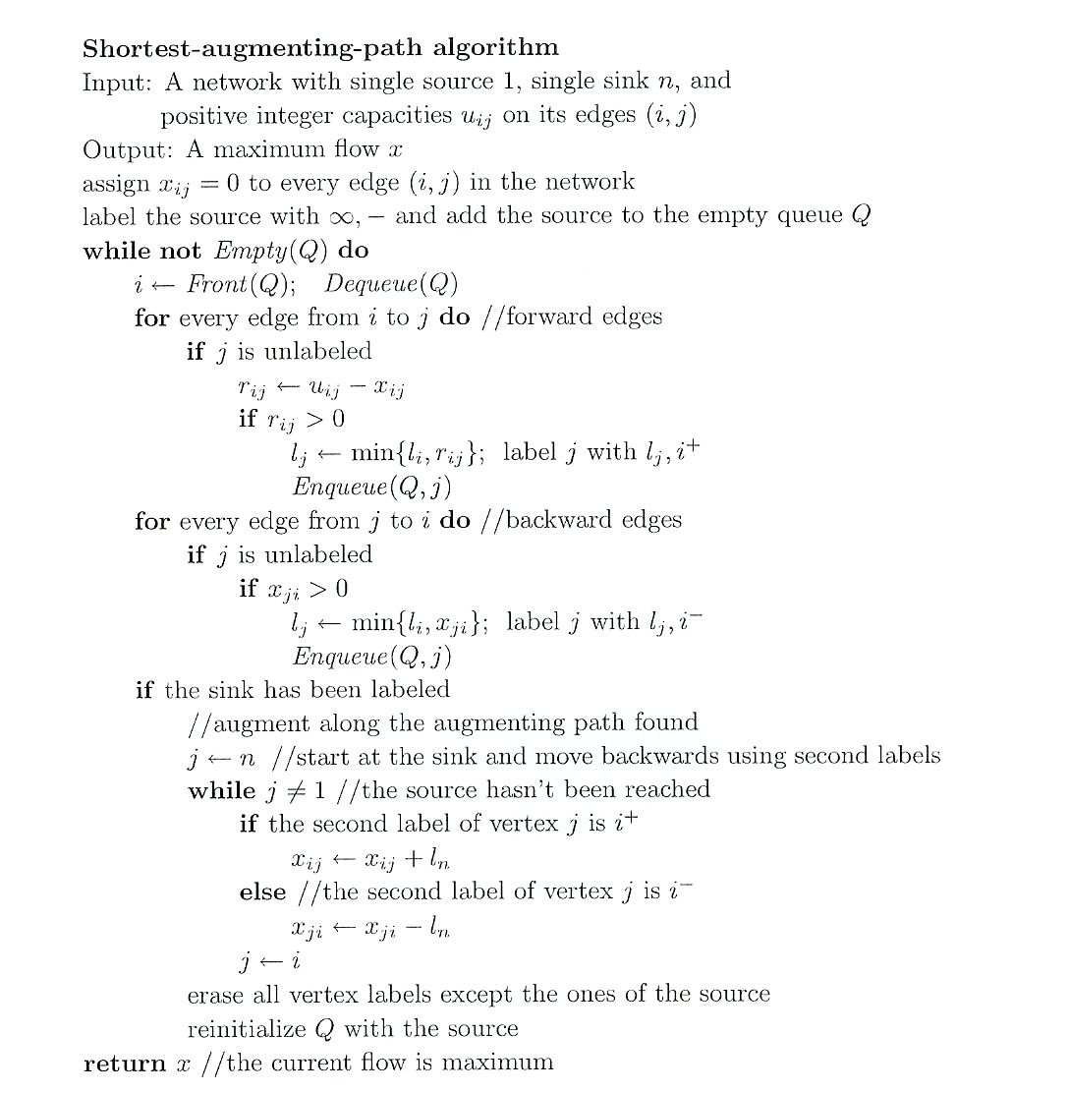

Slide 35
Time Efficiency
The number of augmenting paths needed by the shortest-augmenting-path algorithm never exceeds nm/2, where n and m are the number of vertices and edges, respectively
Since the time required to find shortest augmenting path by breadth-first search is in O(n+m)=O(m) for networks represented by their adjacency lists, the time efficiency of the shortest-augmenting-path algorithm is in O(nm²) for this representation
More efficient algorithms have been found that can run in close to O(nm) time, but these algorithms don’t fall into the iterative-improvement paradigm

Slide 36
Definition of a Cut
Let X be a set of vertices in a network that includes its source but does not include its sink, and let X, the complement of X, be the rest of the vertices including the sink. The cut induced by this partition of the vertices is the set of all the edges with a tail in X and a head in X.
Capacity of a cut is defined as the sum of capacities of the edges that compose the cut.
We’ll denote a cut and its capacity by C(X,X) and c(X,X)
Note that if all the edges of a cut were deleted from the
network, there would be no directed path from source to sink
Minimum cut is a cut of the smallest capacity in a given
network

Slide 37
Examples of network cuts
5
3
4
1
2
2
5
3
2
6
3
1
4
If X = {1} and X = {2,3,4,5,6}, C(X,X) = {(1,2), (1,4)}, c = 5
If X ={1,2,3,4,5} and X = {6}, C(X,X) = {(3,6), (5,6)}, c = 6
If X = {1,2,4} and X ={3,5,6}, C(X,X) = {(2,3), (2,5), (4,3)}, c = 9

Slide 38
Max-Flow Min-Cut Theorem
The value of maximum flow in a network is equal to the capacity of its minimum cut
The shortest augmenting path algorithm yields both a maximum flow and a minimum cut:
  maximum flow is the final flow produced by the algorithm
  minimum cut is formed by all the edges from the labeled vertices to unlabeled vertices on the last iteration of the algorithm
  all the edges from the labeled to unlabeled vertices are full, i.e., their flow amounts are equal to the edge capacities, while all the edges from the unlabeled to labeled vertices, if any, have zero flow amounts on them

Slide 39
Bipartite Graphs
Bipartite graph: a graph whose vertices can be partitioned into two disjoint sets V and U, not necessarily of the same size, so that every edge connects a vertex in V to a vertex in U
A graph is bipartite if and only if it does not have a cycle of an odd length
V
1
2
3
4
5
U
6
7
8
9
10
Notes:
For example, if we have 5 machines and 5 workers where each worker has different skills and can handle different machines. We can represent this as a bipartite graph where the workers are represented by vertices in V and the machines by the vertices in U. An edge between two vertices indicates that the worker has the necessary skill to operate the machine she or he is connected to. By determining the maximum matching (which we will be discussing), we can maximize the number of machines being operated by our workforce.

Slide 40
Bipartite Graphs (cont.)
A bipartite graph is 2-colorable: the vertices can be colored in two colors so that every edge has its vertices colored differently
V
1
2
3
4
5
U
6
7
8
9
10
Notes:
To make this graph no longer bipartite, add an edge between vertices 1 and 2. As you can see this produces a graph that is no longer two colorable (due to the cycle between vertices 1, 2, and 6). To return to a bipartite graph we can either remove this new edge or remove the edge between vertices 2 and 6, making 2 a member of the set U (colored green). This would be another bipartite graph and illustrates that the sets V and U need not be the same size.

Slide 41
Matching in a Graph
A matching in a graph is a subset of its edges with the property that no two edges share a vertex
V
1
2
3
4
5
a matching
in this graph
M = {(4,8), (5,9)}
U
6
7
8
9
10
A maximum (or maximum cardinality) matching is a matching with the largest number of edges
  always exists
  not always unique

Slide 42
Free Vertices and Maximum Matching
V
1
2
3
4
5
A matched
vertex
A matching
in this graph (M)
A free
vertex
U
6
7
8
9
10
For a given matching M, a vertex is called free (or unmatched) if it is not an endpoint of any edge in M; otherwise, a vertex is said to be matched
If every vertex is matched, then M is a maximum matching
If there are unmatched or free vertices, then M may be able to be improved
We can immediately increase a matching by adding an edge connecting two
free vertices (e.g., (1,6) above)

Slide 43
Augmenting Paths and Augmentation
An augmenting path for a matching M is a path from a free vertex in V to a free vertex in U whose edges alternate between edges not in M and edges in M
The length of an augmenting path is always odd
Adding to M the odd numbered path edges and deleting from it the even numbered path edges increases the matching size by 1 (augmentation)
One-edge path between two free vertices is special case of augmenting path
V
1
2
3
4
5
V
1
2
3
4
5
U
6
7
8
9
10
U
6
7
8
9
10
Augmentation along path 2,6,1,7

Slide 44
Augmenting Paths (another example)
V
1
2
3
4
5
V
1
2
3
4
5
U
6
7
8
9
10
U
6
7
8
9
10
Augmentation along
3, 8, 4, 9, 5, 10
Matching on the right is maximum (perfect matching)
Theorem A matching M is maximum if and only if there exists
no augmenting path with respect to M

Slide 45
Augmenting Path Method (template)
Start with some initial matching
  e.g., the empty set
Find an augmenting path and augment the current matching along that path
  e.g., using breadth-first search like method
When no augmenting path can be found, terminate and return the last matching, which is maximum

Slide 46
BFS-based Augmenting Path Algorithm
Initialize queue Q with all free vertices in one of the sets (say V)
While Q is not empty, delete front vertex w and label every unlabeled vertex u adjacent to w as follows:
  Case 1 (w is in V)
  If u is free, augment the matching along the path ending at u by moving backwards until a free vertex in V is reached. After that, erase all labels and reinitialize Q with all the vertices in V that are still free
  If u is matched (not with w), label u with w and enqueue u
  Case 2 (w is in U) Label its matching mate v with w and enqueue v
After Q becomes empty, return the last matching, which is maximum

Slide 47
Example (revisited)
Initial Graph
Resulting Graph
V
1
2
3
4
5
V
1
2
3
4
5
U
6
7
8
9
10
U
6
7
8
9
10
1
Queue: 1 2 3
Queue: 1 2 3
Augment
from 6
Each vertex is labeled with the vertex it was reached from. Queue deletions are indicated by arrows. The free vertex found in U is shaded and labeled for clarity; the new matching obtained by the augmentation is shown on the next slide.
Notes:
In order to provide a more interesting example, we will start with the matching M shown here. After we are finished, if you desire, we can go through the algorithm from the empty set (which is a much more simplistic example).

Slide 48
Example (cont.)
Initial Graph
Resulting Graph
6
8
V
1
2
3
4
5
V
1
2
3
4
5
U
6
7
8
9
10
U
6
7
8
9
10
2
1
3
Queue: 2 3
Queue: 2 3 6 8 1 4
Augment
from 7

Slide 49
Example (cont.)
Initial Graph
Resulting Graph
6
8
V
1
2
3
4
5
V
1
2
3
4
5
U
6
7
8
9
10
U
6
7
8
9
10
3
3
4
4
Queue: 3
Queue: 3 6 8 2 4 9
Augment
from 10

Slide 50
Example: maximum matching found
V
1
2
3
4
5
U
6
7
8
9
10
maximum
matching
This matching is maximum since there are no remaining free vertices in V (the queue is empty)
Note that this matching differs from the maximum matching found earlier

Slide 51
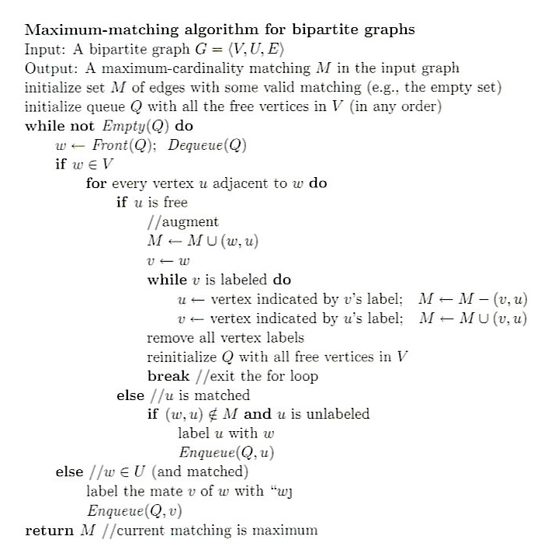

Slide 52
Notes on Maximum Matching Algorithm
Each iteration (except the last) matches two free vertices (one each from V and U). Therefore, the number of iterations cannot exceed ⎣n/2⎦ + 1, where n is the number of vertices in the graph. The time spent on each iteration is in O(n+m), where m is the number of edges in the graph. Hence, the time efficiency is in O(n(n+m))
This can be improved to O(sqrt(n)(n+m)) by combining multiple iterations to maximize the number of edges added to matching M in each search
Finding a maximum matching in an arbitrary graph is much more difficult, but the problem was solved in 1965 by Jack Edmonds

Slide 53
Conversion to Max-Flow Problem
s
1
1
1
1
1
V
1
2
3
4
5
1
1
1
1
1
1
1
1
1
1
U
6
7
8
9
10
1
1
1
1
t
1
Add a source and a sink, direct edges (with unit capacity) from the source to the vertices of V and from the vertices of U to the sink
Direct all edges from V to U with unit capacity

Slide 54
Stable Marriage Problem
There is a set Y = {m₁,…,m_{n}} of n men and a set X = {w₁,…,w_{n}} of n women. Each man has a ranking list of the women, and each woman has a ranking list of the men (with no ties in these lists).
A marriage matching M is a set of n pairs (m_{i}, w_{j}).
A pair (m, w) is said to be a blocking pair for matching M if man m and woman w are not matched in M but prefer each other to their mates in M.
A marriage matching M is called stable if there is no blocking pair for it; otherwise, it’s called unstable.
The stable marriage problem is to find a stable marriage matching for men’s and women’s given preferences.

Slide 55
Instance of the Stable Marriage Problem
An instance of the stable marriage problem can be specified either by two sets of preference lists or by a ranking matrix, as in the example below.
men’s preferences women’s preferences
1st 2nd 3rd 1st 2nd 3rd
Bob: Lea Ann Sue Ann: Jim Tom Bob
Jim: Lea Sue Ann Lea: Tom Bob Jim
Tom: Sue Lea Ann Sue: Jim Tom Bob
ranking matrix
Ann Lea Sue
Bob 2,3 1,2 3,3
Jim 3,1 1,3 2,1
Tom 3,2 2,1 1,2
{(Bob, Ann) (Jim, Lea) (Tom, Sue)} is unstable
{(Bob, Ann) (Jim, Sue) (Tom, Lea)} is stable

Slide 56
Stable Marriage Algorithm (Gale-Shapley)
Step 0 Start with all the men and women being free
Step 1 While there are free men, arbitrarily select one of them and do the following:
Proposal The selected free man m proposes to w, the next woman on his preference list
Response If w is free, she accepts the proposal to be matched with m. If she is not free, she compares m with her current mate. If she prefers m to him, she accepts m’s proposal, making her former mate free; otherwise, she simply rejects m’s proposal, leaving m free
Step 2 Return the set of n matched pairs

Slide 57
Example
 | Ann | Lea | Sue
Bob | 2,3 | 1,2 | 3,3
Jim | 3,1 | 1,3 | 2,1
Tom | 3,2 | 2,1 | 1,2
Free men:
Bob, Jim, Tom
Bob proposed to Lea
Lea accepted
 | Ann | Lea | Sue
Bob | 2,3 | 1,2 | 3,3
Jim | 3,1 | 1,3 | 2,1
Tom | 3,2 | 2,1 | 1,2
Free men:
Jim, Tom
Jim proposed to Lea
Lea rejected

Slide 58
Example (cont.)
 | Ann | Lea | Sue
Bob | 2,3 | 1,2 | 3,3
Jim | 3,1 | 1,3 | 2,1
Tom | 3,2 | 2,1 | 1,2
Free men:
Jim, Tom
Jim proposed to Sue
Sue accepted
 | Ann | Lea | Sue
Bob | 2,3 | 1,2 | 3,3
Jim | 3,1 | 1,3 | 2,1
Tom | 3,2 | 2,1 | 1,2
Free men:
Tom
Tom proposed to Sue
Sue rejected

Slide 59
Example (cont.)
 | Ann | Lea | Sue
Bob | 2,3 | 1,2 | 3,3
Jim | 3,1 | 1,3 | 2,1
Tom | 3,2 | 2,1 | 1,2
Free men:
Tom
Tom proposed to Lea
Lea replaced Bob with Tom
 | Ann | Lea | Sue
Bob | 2,3 | 1,2 | 3,3
Jim | 3,1 | 1,3 | 2,1
Tom | 3,2 | 2,1 | 1,2
Free men:
Bob
Bob proposed to Ann
Ann accepted

Slide 60
Analysis of the Gale-Shapley Algorithm
The algorithm terminates after no more than n² iterations with
a stable marriage output
The stable matching produced by the algorithm is always man-optimal: each man gets the highest rank woman on his list under any stable marriage. One can obtain the woman-optimal matching by making women propose to men
A man (woman) optimal matching is unique for a given set of participant preferences
The stable marriage problem has practical applications such as matching medical-school graduates with hospitals for residency training

